Slide 1
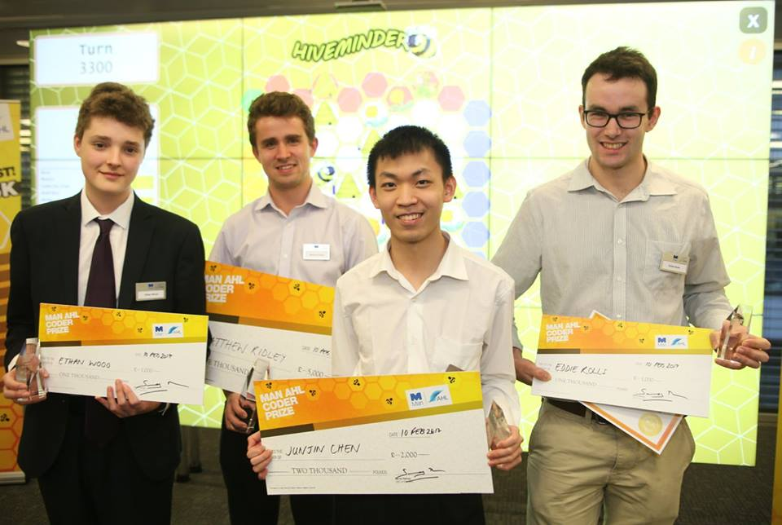
Junjin Chen
First class student, genius.
Maybe a little bit nerd.
Passionate in Programming and Arts.
Strong creativity.

Slide 2
My Strength
Programming
Algorithm 92% in first year.
Know loans of programming languages.
Take parts in coding competitions.
Art
Drawing, Painting when inspired.
Participate in Arts Society.
Often play Draw and Guess.

Slide 3
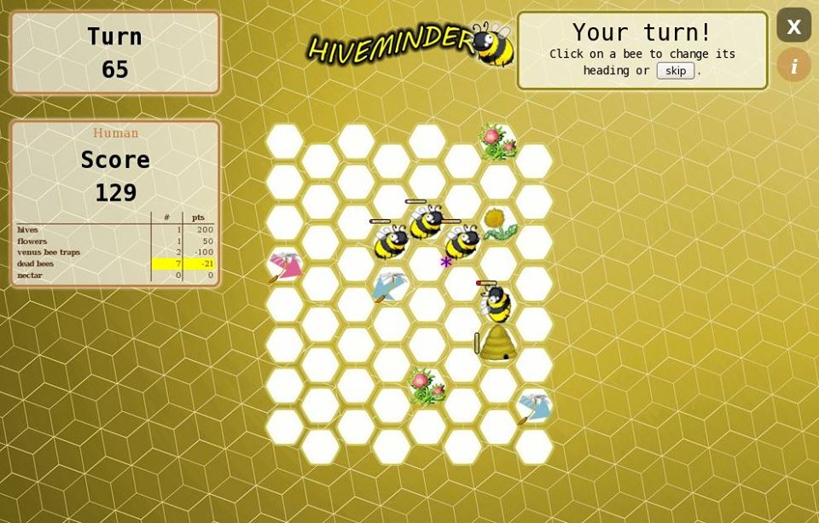
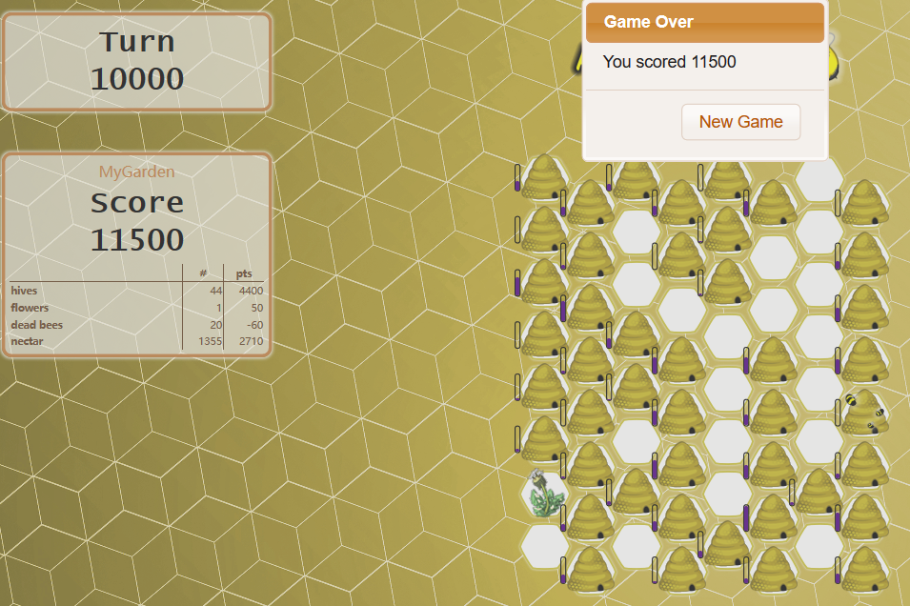
HiveMinder Competition
By MAN AHL
a company managing systematic trading of global markets.
Rule
Agent Control bees to collect nectar and build hive, also control seed to plan flower.
Score scheme.
Algorithm
Best-First.

Slide 4
Play draw and Guess
Rule
Select a word, draw it and people guess.
I often lose

Slide 5
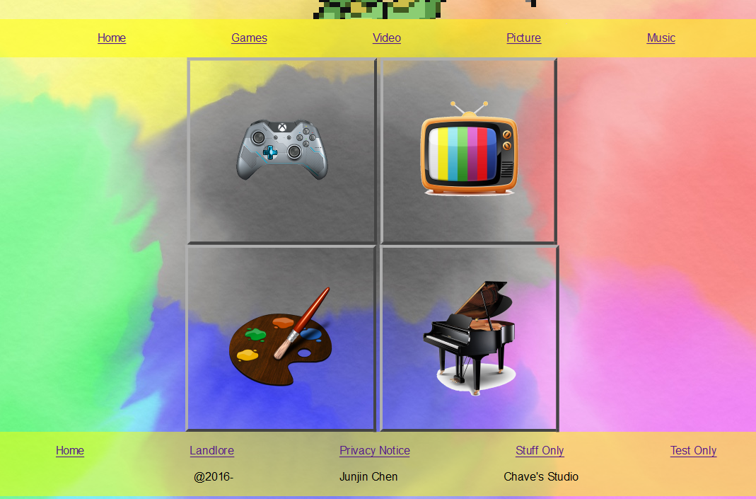
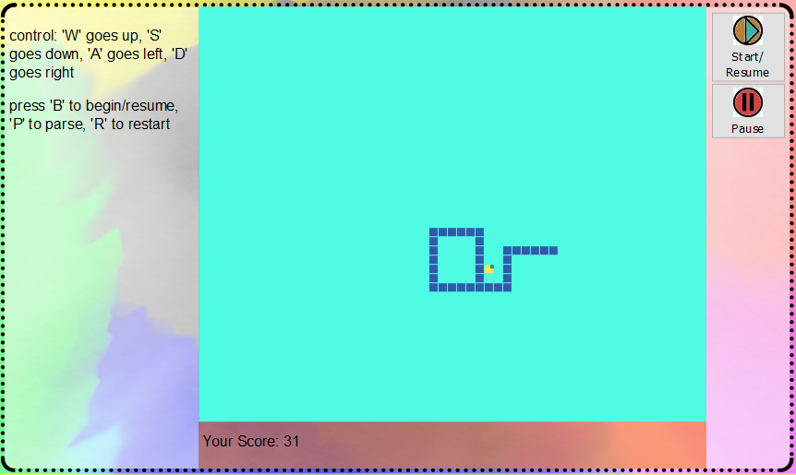
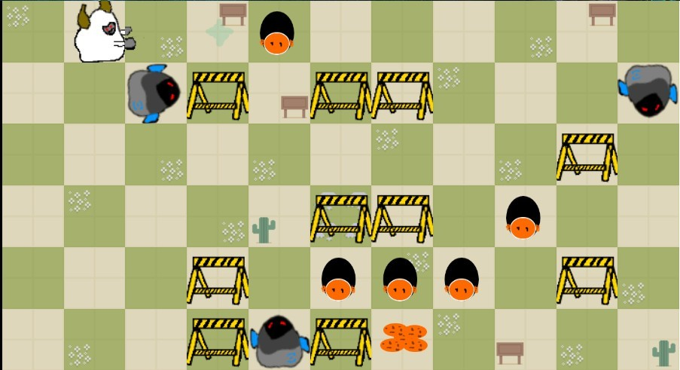
Other things I have done
Software Hut
Working in a team developing liquid democracy system
30hrs game jam
Create a game including designing arts in 30 hours.
Creating my website
Index, games, arts, videos, music. Not published yet.
Research a bit about emotion robot
Emotion Models

Slide 6
My plan
Robot Cinema
It is amazing to see those robots mimic human characteristic
Coding emotion system for robot.
Scene: some bad guys robots are bullying robots then one hero robot stands out and unite other robots to beat those bad guys robots.

Slide 7
Thank you
Any Questions?

Slide 8
My question
How many places are available?

